Slide 1
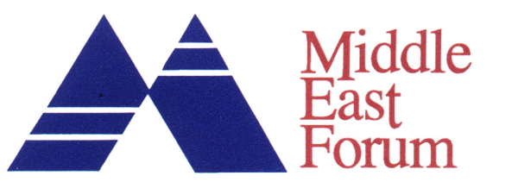
Saudi Arabia and Egypt
Poll Results
November 2009

Slide 2
November 2009 Poll Overview
Poll sponsored by the Middle East Forum; overseen by Pechter Middle East Polls, LLC; and conducted by a credible, private, local Middle East company with a solid track record.
Respondents interviewed in Arabic in their own homes; Egypt national, Saudi Arabia urban only.
N=1000; Margin of error=3%.
<3 weeks to conduct interviews and return a data set in SPSS.
Notes:
2

Slide 3
Assuming the Iranian government continues its nuclear enrichment program, would you support an Israeli strike against Iranian nuclear facilities?
Egypt
Saudi Arabia
* Rounded Percentages © 2009 by the Middle East Forum. All rights reserved.
Notes:
3

Slide 4
Assuming the Iranian government continues its nuclear enrichment program, would you support an Israeli strike against Iranian nuclear facilities?
Egypt
Saudi Arabia
80
76
25
17
Somewhat Support Strongly Support Somewhat Oppose Strongly Oppose
* Rounded Percentages © 2009 by the Middle East Forum. All rights reserved.
Notes:
4

Slide 5
How about an American strike against the Iranian nuclear facilities?
Egypt
Saudi Arabia
* Rounded Percentages © 2009 by the Middle East Forum. All rights reserved.
Notes:
5

Slide 6
How about an American strike against the Iranian nuclear facilities?
Egypt
Saudi Arabia
73
65
35
25
Somewhat Support Strongly Support Somewhat Oppose Strongly Oppose
* Rounded Percentages © 2009 by the Middle East Forum. All rights reserved.
Notes:
6

Slide 7
American vs Israeli Strike
Egypt
Saudi Arabia
* Rounded Percentages © 2009 by the Middle East Forum. All rights reserved.
Notes:
7

Slide 8
Islam defines the state of Egypt/Saudi Arabia; under the right circumstances, would you accept a Jewish State of Israel?
Egypt
Saudi Arabia
* Rounded Percentages © 2009 by the Middle East Forum. All rights reserved.
Notes:
8

Slide 9
Acceptance of Jewish State of Israel vs. Support for Israeli Strike
Egypt
Saudi Arabia
* Rounded Percentages © 2009 by the Middle East Forum. All rights reserved.
Notes:
9

